Slide 1
Phishing Detection System Through Hybrid Machine Learning Based on URL
</
/>
Presentation for :: Cryptography and Network Security (CNS), under the Guidance of -
Ms. Nisha H Songire
Coordinator : A2-B2 Batch
Team Leader:
Asst. Leader:
Team Member - 01
Team Member - 02
Chinmay Beedkar (2020BCS052)
Mahesh Chaware
(2020BCS066)
Galpelli Yash
(2020BCS075)
K. Priyanshu
(2020BCS063)

Slide 2
</ Agenda />
Topic Introduction
Prevention from Phishing
Research Paper Demonstration
Solutions using Machine Learning
Comparative Analysis of Algorithms & Conclusion

Slide 3

</What is Phishing?
INTRODUCTION
Definition:
Phishing is a type of cyber attack
Deceptive attempt to steal sensitive information
Goal:
To trick individuals into revealing personal or financial information
Targets:
Anyone can be a target

Slide 4


</ What is Phishing?
INTRODUCTION
Common Techniques:
Fake Websites:
Mimic popular sites to steal data
Spoofed Emails:
Fake Messages that look Legitimate
Social Engineering:
Manipulating the Human Trust and emotions

Slide 5
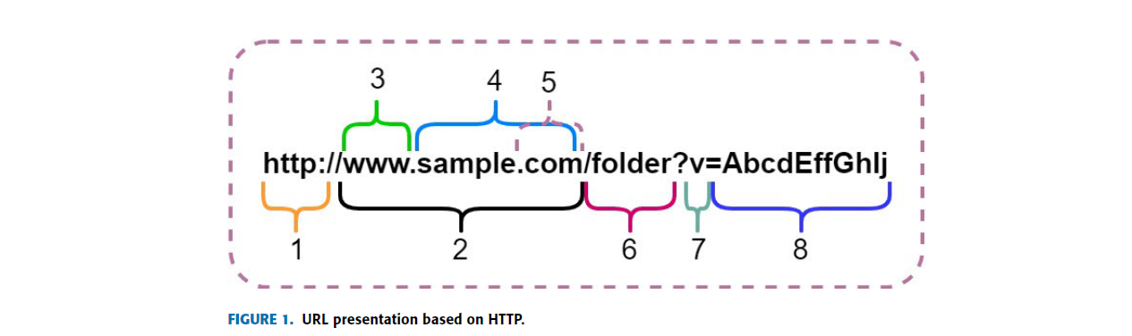
</ What is an URL?
INTRODUCTION
URL - Uniform Resource Locator which was developed Berners-Lee (1994).
The format of the URL is defined by preexisting sources and protocols.

Slide 6
</ What is an URL?
INTRODUCTION
1) HTTP Protocol
7) v here holds the 8 in the short form (AbcdEffGhIj)
2) Hostname: subdivided into (3,4,5)
7 aspects of
URL
6) Directory of the web server
3) Local Name (www.)
5) Lower Level Domain (.com / .in / .org)
4) Top Level Domain (web Address – “sample”)

Slide 7
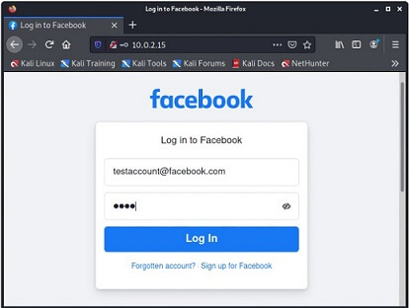
</ Malicious URL Techniques in Phishing
INTRODUCTION
CLONED WEBSITES
Attackers often create URLs that closely resemble legitimate websites or services.
They use techniques like domain spoofing or altering letters to make the URL appear genuine at first glance.

Slide 8
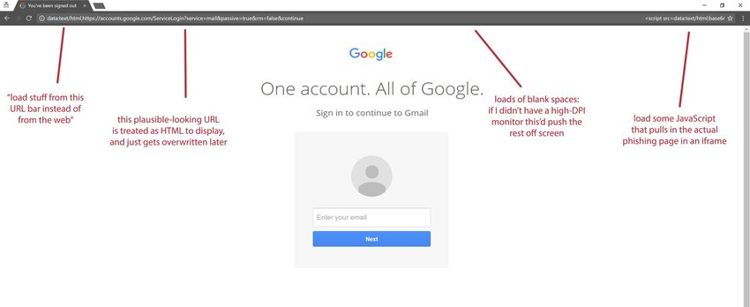
</ Malicious URL Techniques in Phishing
INTRODUCTION
FAKE LOGIN PAGES:
Phishers craft URLs that lead users to fake login pages that mimic well-known websites, such as banks, social media platforms, or email providers
Users are prompted to enter their credentials, believing they are logging into a trusted account.

Slide 9


</ Why is it necessary to stop the phishing?
Preventive Measures
Phishing means “Online Thievery”
The pirates want our information like –
account numbers, passwords, Social Security numbers, and other confidential information that they can use to loot your checking account or run up bills on your credit card
It may go upto IDENTITY THEFT as well
So to protect ourself from this crime we need to take preventive measures

Slide 10
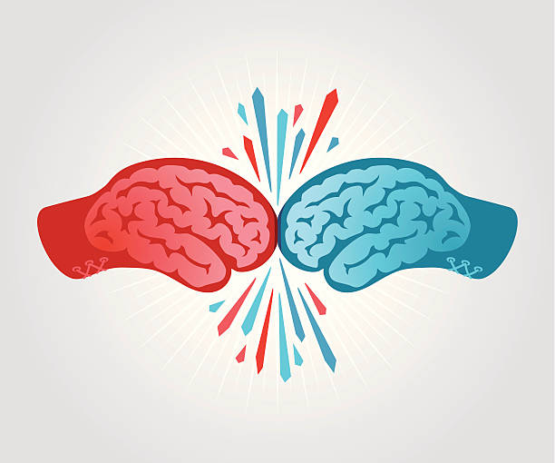


</ What are the various methods to do so?
Preventive Measures
1. LIST BASED PHISHING IDENTIFICATION SYSTEM
Whitelisting: lists of known legitimate websites; used to allow access to only legitimate websites
Blacklisting: lists of known phishing URLs; used to block access to phishing websites.
V/S

Slide 11

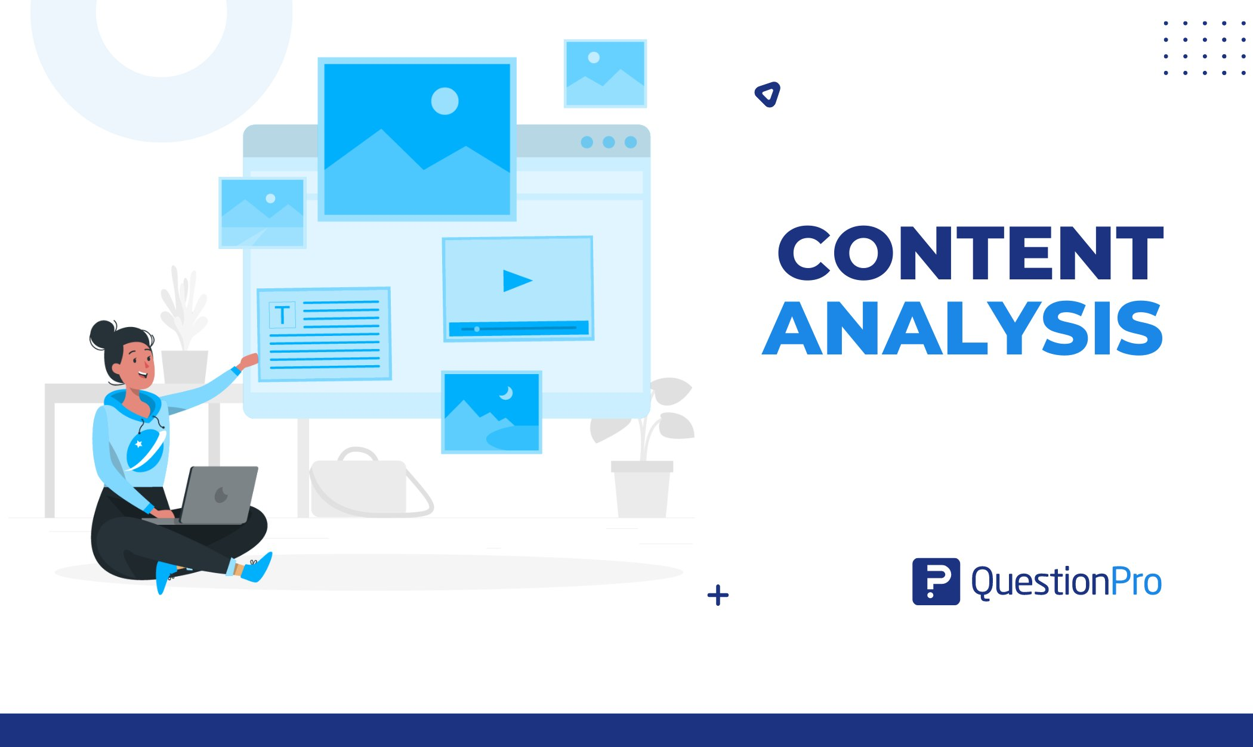
Preventive Measures
</ What are the various methods to do so?
2. Content BASED PHISHING IDENTIFICATION SYSTEM
Content Analysis: process of analyzing the content of a website to determine if it is legitimate or phishing
(look for keywords or phrases that are commonly used in phishing websites)
User Behavior Analysis: process of tracking the behavior of users to identify suspicious activity (number of times a user clicks on a link or the number of times a user enters their personal information)

Slide 12

</ How to Avoid Phishing using ML?
Solutions Using Machine Learning
Phishing URL detection using machine learning is a process of identifying phishing websites or URLs using machine learning algorithms.
Machine learning algorithms are trained on a dataset of known phishing and legitimate URLs.
The features of the URLs, such as the domain name, the length of the URL, the presence of hyphens or underscores, and the use of typos, are extracted and used to train the machine learning model.

Slide 13

</ Algorithms that can be used:
Solutions Using Machine Learning
ML Algorithms
Linear & Probability Approach
Hybrid Approach
Tree Based Algorithms approach
- Support Vector Classifier
- (LR + SVC + DT)
- Decision Tree
- Logistic Regression
- Random Forest Algo.
- Neural Networks

Slide 14
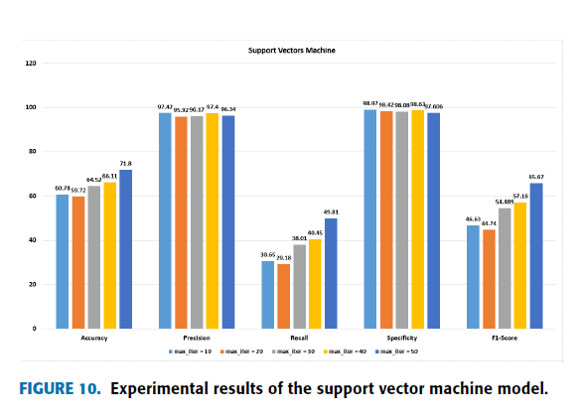
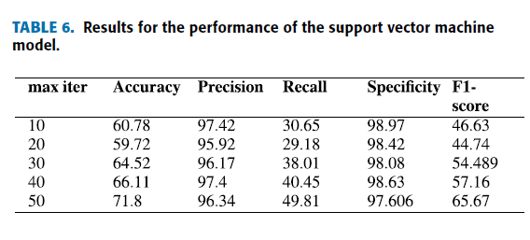
</ Algorithms that can be used:
Solutions Using Machine Learning
# Support Vector Classifier
SVM is a supervised learning algorithm that can be used for classification and regression tasks. SVM works by finding the hyperplane that best separates the two classes of data.

Slide 15
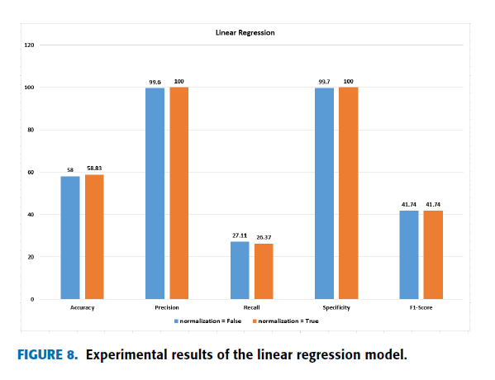
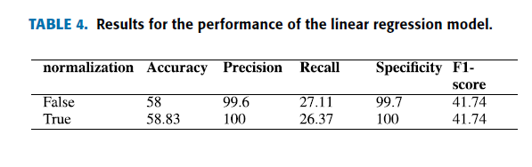
</ Algorithms that can be used:
Solutions Using Machine Learning
# Logistic Regression Model
Logistic regression is a supervised learning algorithm that can be used for classification tasks. Logistic regression works by fitting a logistic curve to the data to predict the probability of a data point belonging to a particular class

Slide 16
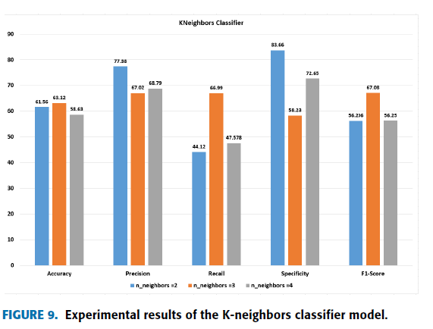
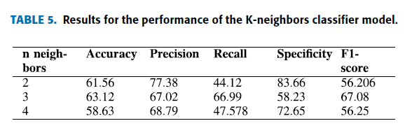
</ Algorithms that can be used:
Solutions Using Machine Learning
# Neural Networks
Neural networks are a type of machine learning algorithm that is inspired by the human brain. Neural networks can be used for a variety of tasks, including classification, regression, and clustering.

Slide 17
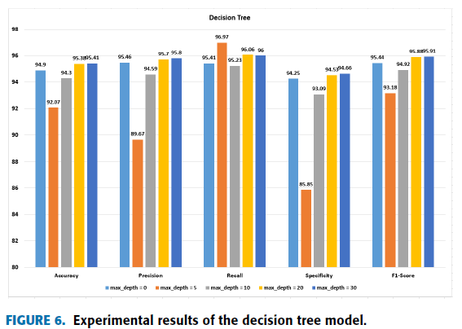
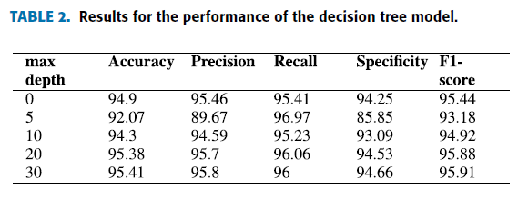
</ Algorithms that can be used:
Solutions Using Machine Learning
# Decision Tree Algorithm
Decision trees are a non-parametric supervised learning algorithm that can be used for classification and regression tasks. Decision trees work by creating a tree-like structure of decisions that leads to the classification of a data point.

Slide 18
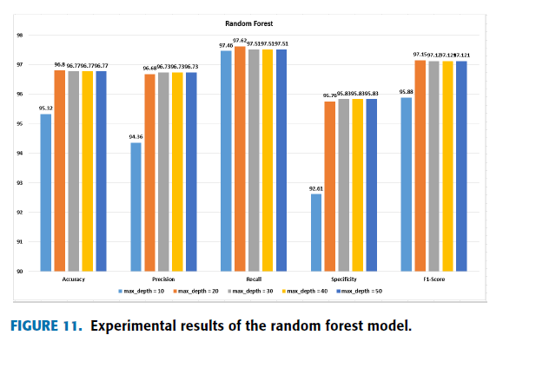
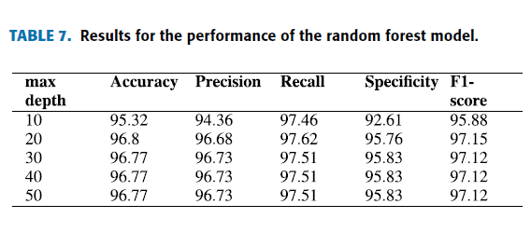
</ Algorithms that can be used:
Solutions Using Machine Learning
# Random Forest Algorithm
Random forests are an ensemble learning algorithm that combines multiple decision trees to improve the accuracy of the model.

Slide 19
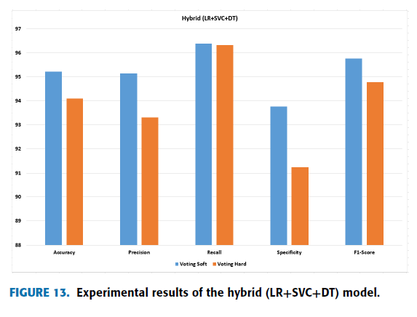
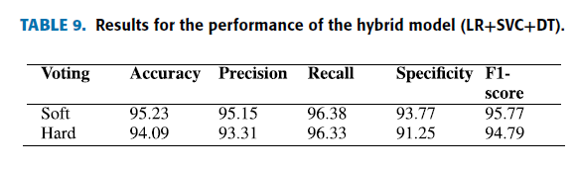
</ Algorithms that can be used:
Solutions Using Machine Learning
# Hybrid Algorithms
(LR + SVC + DT)

Slide 20
</ Comparative Analysis & Conclusion
Comparative Analysis & Conclusion
The highest results were achieved with proposed approach of the
HYBRID MACHINE LEARNING ALGORITHMS, with an accuracy of 98.12%, precision of 97.31%, recall of 96.33%, specificity of 96.55%, and F1-score of 95.89%, which outperformed the other utilized machine learning models.
machine learning model that consists of linear approaches or
probabilistic approaches, such as linear regression and support vector machines, do not perform very well and show very low results.
The ensemble and tree-based models presented highly effective and
significant results in the classification of phishing URLs.
Tree architecture-based models presented better results than linear and probabilistic models
The hybrid model performed better and yielded higher accuracy
results than the other machine learning models

Slide 21
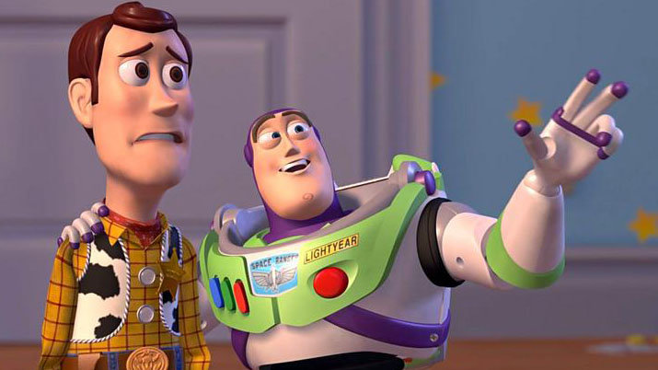
</ Comparative Analysis & Conclusion
Comparative Analysis & Conclusion
Some other Solutions:
User education
DMARK – Domain Based Message Authentication
WAF – Web Application Firewalls
MFA – Multi Factor Verification
SEG – Secure Email Gateways.
Don’t Worry woody, SGGSIE&Tians are here to take care of the Phishing problem…!!!!
And Many More are on the brink of coming into the real-world application from the brilliant minds of wonderful engineers, the responsibility is lying with us...

Slide 22



Slide 23
</New operating system design
Mars is actually a cold planet
Venus is a very hot planet
Mars
Venus
Earth
Jupiter
Saturn
Earth is the planet with life
It doesn’t have a solid surface
It was named after a Roman god

Slide 24
</New operating system design
Jenna Doe
Kelly Smith
Venus is a very hot planet
Earth is the planet with life
Juan Jones
John Martin
Mars is full of iron oxide dust
Mercury is a small planet

Slide 25
</New operating system design
Problem
Process
Solution
{01}
{02}
{03}
Analysis
Evaluation
Synthesis
Earth is the planet with life
Mars is full of iron oxide dust
Jupiter is a huge gas giant

Slide 26
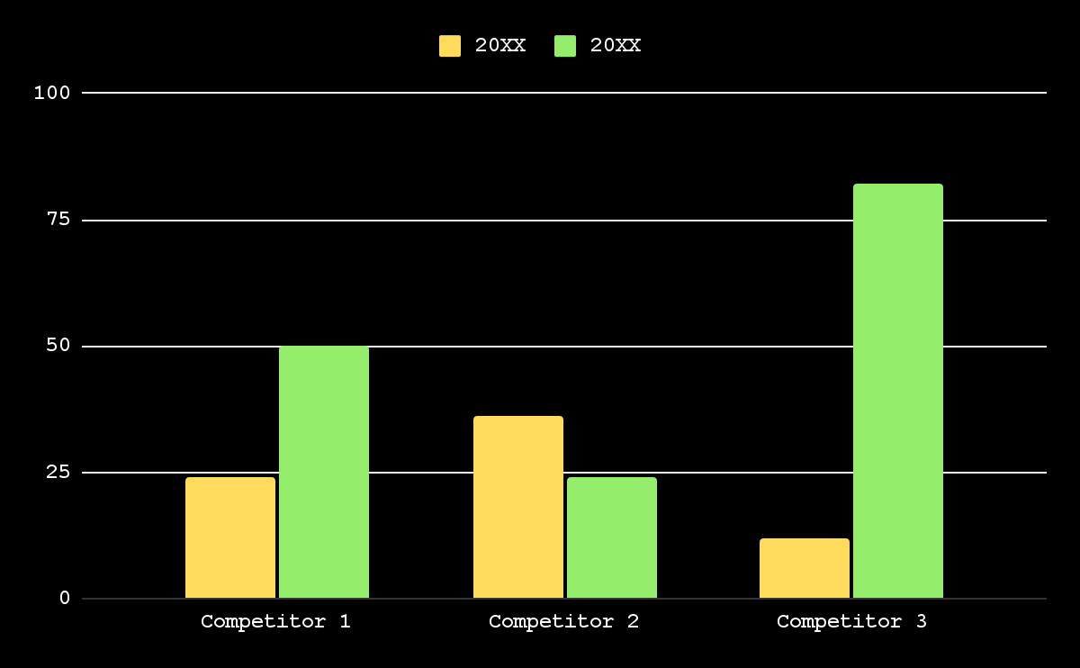
</New operating system design
20XX
Earth is the third planet from the Sun
20XX
Venus is the second planet from the Sun
Follow the link in the graph to modify its data and then paste the new one here. For more info, click here

Slide 27
</New operating system design
Venus
{01}
{02}
Mercury
It’s a hot planet
Mercury is small
Mars
{03}
{04}
Saturn
Mars is very cold
Saturn has rings
Earth
{05}
{06}
Neptune
Earth has life
It’s an ice giant
Jupiter
{07}
{08}
Pluto
Jupiter is big
It’s a dwarf planet

Slide 28
</New operating system design
Mercury
Venus
Earth
Jupiter
Saturn
Neptune
Earth is the planet with life
It doesn’t have a solid surface
It was named after a Roman god
Neptune is very far from us
40%
60%
20%
80%

Slide 29
</New operating system design
Venus
Mercury
{01}
{02}
It’s the second planet from the Sun
It’s the closest planet to the Sun
Earth
Mars
{03}
{04}
It’s the third planet from the Sun
Despite being red, Mars is very cold

Slide 30
</New operating system design
{10M}
Venus
Venus is a very hot planet
{1M}
Mars
Mars was named after a god
{10K}
Jupiter
Jupiter is a huge gas giant
{5K}
Saturn
Saturn has beautiful rings
{1K}
Neptune
Neptune is very far from us

Slide 31
</New operating system design
Our plans | Description | Price
Free | Mercury is the closest planet to the Sun Mercury is very small | $50
Freemium | Venus is the second planet from the Sun Venus is a hot planet | $75
Premium | Earth is the third planet from the Sun Earth is the planet with life We all live on Earth | $200

Slide 32
</New operating system design
{01}
{02}
{03}
Vision
Mission
Goals
Neptune is the farthest planet from the Sun
Saturn is composed mostly of hydrogen and helium
Despite being red, Mars is actually a cold place

Slide 33
</New operating system design
{50%}
Venus is the second planet from the Sun
{70%}
Mercury is the closest planet to the Sun
{10%}
Despite being red, Mars is very cold
{20%}
Jupiter is the biggest planet of them all
{90%}
Saturn was named after a Roman god

Slide 34
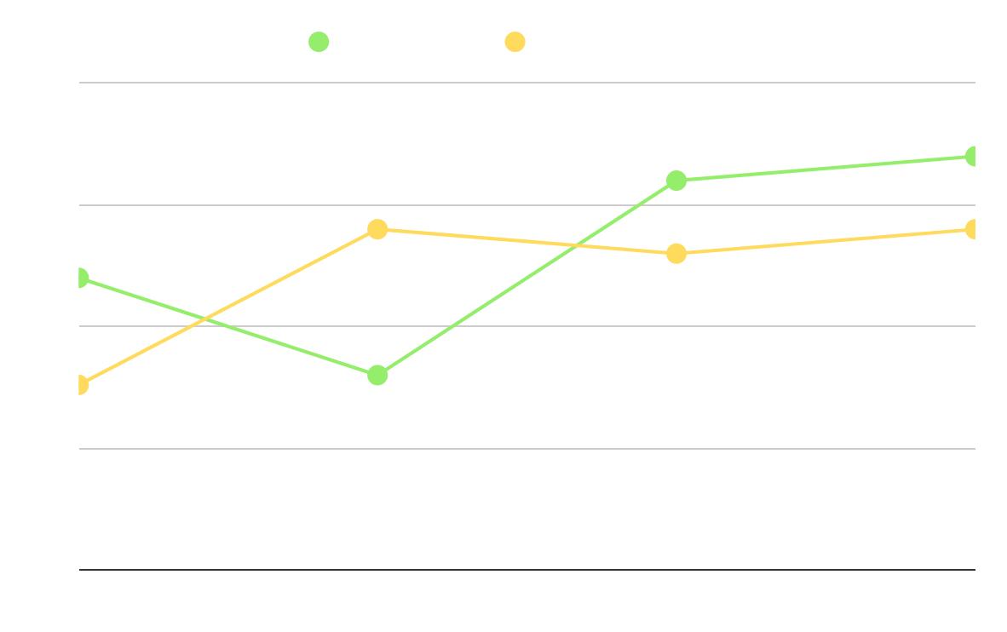
</New operating system design
Our company
Their company
Earth is the third planet from the Sun
Venus is the second planet from the Sun
Analysis
Saturn is a gas giant and has several rings. It’s composed mostly of hydrogen and helium
Follow the link in the graph to modify its data and then paste the new one here. For more info, click here

Slide 35
</New operating system design
{2/5}
By Mark Jones
{5/5}
By Timmy Jimmy
“Venus is the second planet from the Sun”
“Despite being red, Mars is very cold”
{4/5}
By Kim Williams
{3/5}
By Sue Lawson
“Jupiter doesn’t have a solid surface”
“Earth is the planet with life”

Slide 36
</New operating system design
Jupiter
It doesn’t have a solid surface
Mercury
Mercury is the closest planet to the Sun and the smallest of them all
Earth
Earth is the planet with life

Slide 37
</New operating system design
S
W
O
T
Strengths
Weaknesses
Opportunities
Threats
Earth is the planet with life
Jupiter is a huge gas giant
Mars is actually a cold place
Neptune is very far from us

Slide 38
</New operating system design
Brainstorming
Preparation
Facilitation
Venus is the second planet from the Sun
Despite being red, Mars is very cold
Follow through
Earth is the third planet from the Sun

Slide 39
</New operating system design
{01}
Awareness
Venus is a very hot planet
{02}
Interest
Mars was named after a god
{03}
Decision
Jupiter is a huge gas giant
{04}
Purchase
Saturn has beautiful rings

Slide 40
</New operating system design
 | Mon | Tue | Wed | Thu | Fri
Week 1 |  | Jupiter is a big planet
Week 2 |  |  | Mercury is a small planet
Week 3 |  |  |  |  | We all live on Earth
Week 4 | Neptune is an ice giant
</Jupiter
</Mercury
</Earth
</Neptune

Slide 41
</New operating system design
Budget model
It’s the closest planet to the Sun
It’s the second planet from the Sun
It doesn’t have a solid surface
Mercury
Venus
Jupiter
{30%}
{20%}
{50%}
{4,000,000}

Slide 42
</New operating system design
Mars was named after a god
Saturn has beautiful rings
Mars
Saturn
{20XX}
{20XX}
{20XX}
{20XX}
{20XX}
Venus
Jupiter
Earth
Venus is a very hot planet
Jupiter is a huge gas giant
It’s the planet with life

Slide 43
</New operating system design
Venus
Mars
It’s the second planet from the Sun
Despite being red, Mars is very cold
Earth
Jupiter
It’s the third planet from the Sun
It doesn’t have a solid surface

Slide 44
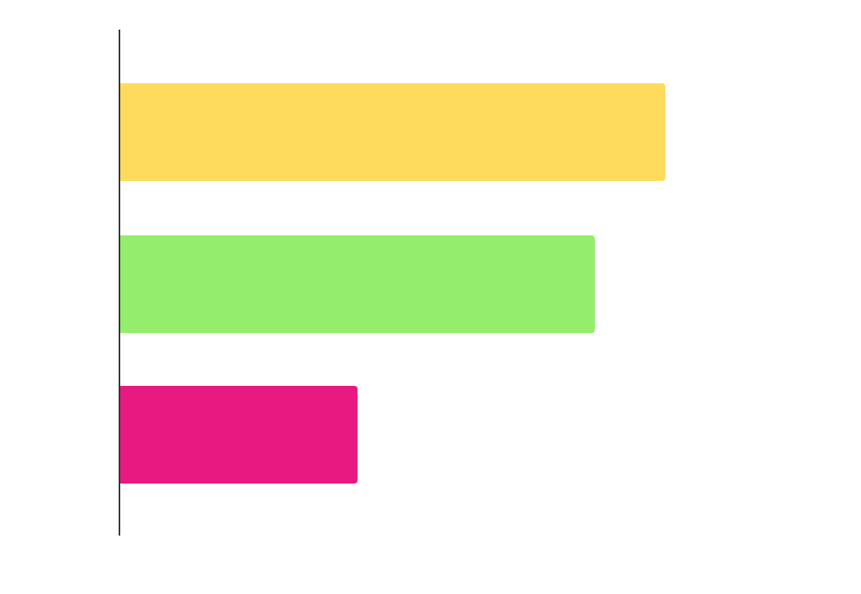
</New operating system design
{23K}
Mars
Mars was named after a god
{20K}
Venus
Venus is a very hot planet
{10K}
Jupiter
Jupiter is a huge gas giant
Follow the link in the graph to modify its data and then paste the new one here. For more info, click here

Slide 45
</New operating system design
Venus
{01}
Venus is a very hot planet
Mars
{02}
Mars was named after a god
Jupiter
{03}
Jupiter is a huge gas giant
Saturn
{04}
Saturn has beautiful rings

Slide 46
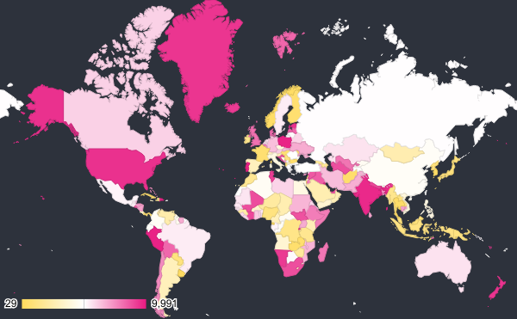
</New operating system design
Earth
Jupiter
Earth is the planet with life
It doesn’t have a solid surface
{4,000,000}
Saturn
It was named after a Roman god
Venus is the second planet from the Sun
Follow the link in the map to modify its data and then paste the new one here. For more info, click here

Slide 47
</New operating system design
Awards
Best team
Innovation
Experimental
Venus is the second planet from the Sun
Despite being red, Mars is very cold
Earth is the third planet from the Sun

Slide 48
</New operating system design
Mon | Tue | Wed | Thu | Fri | Sat | Sun
1 | 2 | 3 | 4 | 5 | 6 | 7
8 | 9 | 10 | 11 | 12 | 13 | 14
15 | 16 | 17 | 18 | 19 | 20 | 21
22 | 23 | 24 | 25 | 26 | 27 | 28
29 | 30
</Task 1
</Task 2
</Task 3
</Task 4

Slide 49
</New operating system design
Venus is the second planet from the Sun
Despite being red, Mars is actually a cold place
Earth is the planet on which we all live
Jupiter is the biggest planet in the Solar System
Venus
Mars
Earth
Jupiter
{01}
{02}
{03}
{04}

Slide 50
Instructions for use
If you have a free account, in order to use this template, you must credit Slidesgo in your final presentation. Please refer to the next slide to read the instructions for premium users.
As a Free user, you are allowed to:
- Modify this template.
- Use it for both personal and commercial projects.
You are not allowed to:
- Sublicense, sell or rent any of Slidesgo Content (or a modified version of Slidesgo Content).
- Distribute Slidesgo Content unless it has been expressly authorized by Slidesgo.
- Include Slidesgo Content in an online or offline database or file.
- Offer Slidesgo templates (or modified versions of Slidesgo templates) for download.
- Acquire the copyright of Slidesgo Content.
For more information about editing slides, please read our FAQs or visit our blog:
https://slidesgo.com/faqs and https://slidesgo.com/slidesgo-school

Slide 51
Instructions for use (premium users)
As a Premium user, you can use this template without attributing Slidesgo.
You are allowed to:
Modify this template.
Use it for both personal and commercial purposes.
Share this template in an editable format with people who are not part of your team.
You are not allowed to:
Sublicense, sell or rent this Slidesgo Template (or a modified version of this Slidesgo Template).
Distribute this Slidesgo Template (or a modified version of this Slidesgo Template) or include it in a database or in any other product or service that offers downloadable images, icons or presentations that may be subject to distribution or resale.
Use any of the elements that are part of this Slidesgo Template in an isolated and separated way from this Template.
Register any of the elements that are part of this template as a trademark or logo, or register it as a work in an intellectual property registry or similar.
For more information about editing slides, please read our FAQs or visit our blog:
https://slidesgo.com/faqs and https://slidesgo.com/slidesgo-school

Slide 52
Infographics
You can add and edit some infographics to your presentation to present your data in a visual way.
Choose your favourite infographic and insert it in your presentation using Ctrl C + Ctrl V or Cmd C + Cmd V in Mac.
Select one of the parts and ungroup it by right-clicking and choosing “Ungroup”.
Change the color by clicking on the paint bucket.
Then resize the element by clicking and dragging one of the square-shaped points of its bounding box (the cursor should look like a double-headed arrow). Remember to hold Shift while dragging to keep the proportions.
Group the elements again by selecting them, right-clicking and choosing “Group”.
Repeat the steps above with the other parts and when you’re done editing, copy the end result and paste it into your presentation.
Remember to choose the “Keep source formatting” option so that it keeps the design. For more info, please visit our blog.

